Slide 1
COMP6049 – Algorithm Design and Analysis
Topic 3 – Algorithm & Complexity Functions

Slide 2
Outline Materials
Steps top develop an algorithm
Steps top develop an algorithm
Complexity function

Slide 3
BASIC STEPS OF ALGORITHM
Simplify problem
Build mathematically solving plan
Design an algorithm
Test correctness of the algorithm
Implement the algorithm to a programming language
Documentation
Analyze complexity of the algorithm

Slide 4
PROCESSING TIME OF ALGORITHM
Processing time of algorithm is time duration needed by a computer to run an algorithm.
We do not aware processing time if we use computer with higher speed.
Not all algorithms can be proceed less than one second.
A complex algorithm needs processing time in minutes to days processing even we use a sophisticated computer.
Very important to calculate time processing in designing of a complex algorithm.

Slide 5
PROCESSING TIME TYPES
An algorithm works based on input from user.
Each input has a size. For example we want to sort some numbers, the number of numbers that need to be sorted is the size of the input.
The larger the size of the input is entered, usually processing will take longer.
Depending on input, processing time may vary:
Best case
Notation θ(...) read Theta
Average case
Notation Ω(...) read Omega
Worst case
Notation O(...) read Big-O
Performance of an algorithm is usually measured by using a benchmark for the worst (worst case) that is expressed with the Big-O

Slide 6
ALGORITHM
Definition 1 : worst time
if there are two constant number c and n_{o} ∋
Theorem: Example
Is a polynomial degree n, then

Slide 7
ALGORITHM
Definition 2 : best time
if there are two constant c and n_{o} ∋

Slide 8
ALGORITHM
Definition 3 : average time
if there are three positive constant c₁, c₂, and n_{o} ∋

Slide 9
CALCULATING PROCESSING TIME (1)
Example: Algorithm for Selection Sort
1 for i=1 to N-1 do
2 min=i
3 for j=i+1 to N do
4 if A[j]<A[min] then
5 min=j
6 end if
7 end for
8 swap(A[i],A[min])
9 end for
Calculate processing time of an algorithm to sort 8 random numbers.

Slide 10
CALCULATING PROCESSING TIME (2)
The assumption value of N is unknown
Can be calculated that for every iteration i will happen iteration j-1 of N, N-2, N-3, ..., 1 time
Suppose the value of N is 5, then we need to calculate 5 +4 +3 +2 +1 (formulas arithmetically)
If value of a and b = 1 then :

Slide 11
GROWTH RATE
Complexity function formula N (N +1) / 2 means that if N = 5, the processing time is 15. If N is changed to 8, then the processing time is 36.
Value of N and processing time can be mapped in Cartesian
Value of N and processing time can be mapped in a Cartesian coordinate with the N on the x-axis and time on the y axis.
The Selection Sort algorithm processing time to grow (growth rate) linear.

Slide 12
COMPLEXITY FUNCTION
Function of algorithm complexity for Selection Sort is:
Types of complexity function:
Big Oh
f(n) is O(n) if there is c > 0 and n₀ ≥ 1 that satisfy f(n) ≤ c.g(n) for n ≥ n₀
Big Omega
f (n) is Ω (n) if there is c > 0 and n₀ ≥ 1 that satisfy f (n) ≥ c.g(n) for n ≥ n₀
Big Theta
f(n) is θ(n) if there is c₁ > 0, c₂ > 0 and n₀ ≥ 1 that satisfy c₁.g(n) ≤ f(n) ≤ c₂.g(n) for n ≥ n₀
Little oh
f(n) is ο(n) there is c > 0 and n₀ ≥ 0 that satisfy f(n) ≤ c.g(n) for n ≥ n₀
Little omega
f(n) is ω(n) there is c > 0 and n₀ ≥ 0 that satisfy f(n) ≥ c.g(n) for n ≥ n₀

Slide 13
ANALYSIS OF ALGORITHM COMPLEXITY
A priori analysis
Analysis processing time of an algorithm that expressed in a function
A posteriori testing
analysis by carrying out a number of experiments to determine the exact processing time of an algorithm on a particular computer; can also be performed to obtain statistical data of the processing time and the amount of memory space used;

Slide 14
BIG-OH
O(1) means constant algorithm
O(n) means linear algorithm
O(n²) means quadratic algorithm
O(n³) means cubic algorithm
O(log n) for example full balanced Binary Search Tree
O(n^{m}) means exponential algorithm
Big-O notation can contain combination of above
Simplifying of Big-O is for “less important” component

Slide 15
EXERCISE
Calculate and EXPLAIN the complexity of algorithm below:
F(n) = {
count = 0 FOR i = 1 to n DO
IF n MODULO i = 0 THEN
count = count + 1
END IF
END FOR
IF count = 2 THEN
RETURN PRIME
ELSE
RETURN NOT-PRIME
END IF
}

Slide 16
EXERCISE
Calculate and EXPLAIN the complexity of algorithm below:
F(n) = F(n/3) +1
with F(0) is 0
Calculate and EXPLAIN the complexity of function that calculate the n-th Fibonacci number.
F(n) = F(n-1) + F(n-2)

Slide 17
SOLUTION
Calculate and EXPLAIN the complexity of algorithm below:
F(n) = {
count = 0 FOR i = 1 to n DO
IF n MODULO i = 0 THEN
count = count + 1
END IF
END FOR
IF count = 2 THEN
RETURN PRIME
ELSE
RETURN NOT-PRIME
END IF
}
The algorithm above has the complexity of O(n).
(The explanation is left for exercise)

Slide 18
EXERCISE
Calculate and EXPLAIN the complexity of algorithm below:
F(n) = F(n/3) +1
with F(0) is 0
The algorithm above has the complexity of O(lg₃ n).
(The explanation is left for exercise)
Calculate and EXPLAIN the complexity of function that calculate the n-th Fibonacci number.
F(n) = F(n-1) + F(n-2)
The algorithm above has the complexity of O(φ^{n}) – φ is golden ratio (1.6180339887)
(The explanation is left for exercise)

Slide 19
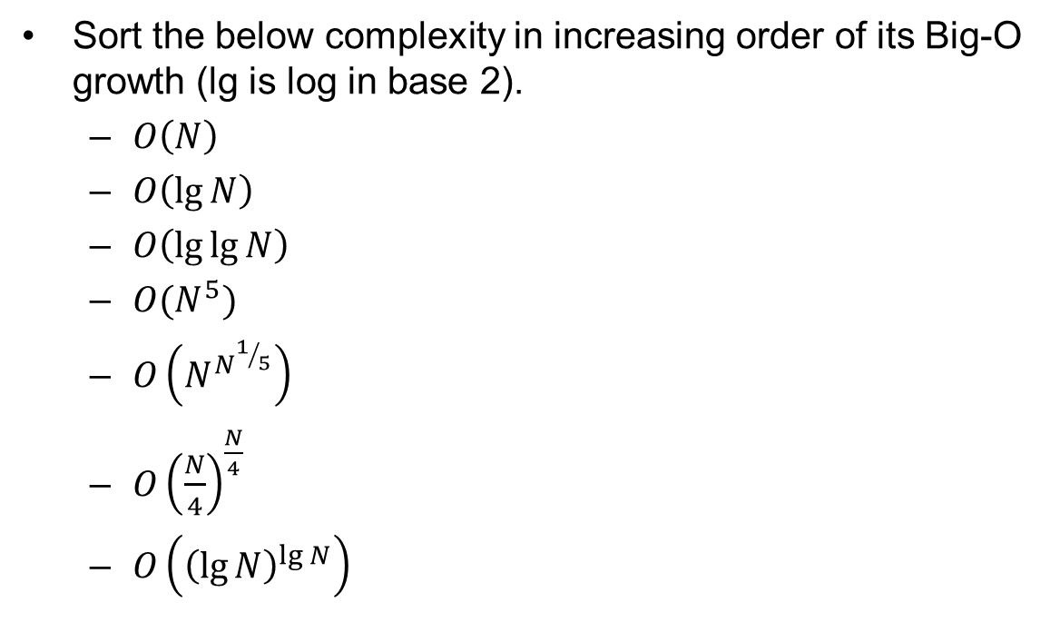
EXERCISE
Sort the below complexity in increasing order of its Big-O growth (lg is log in base 2).
$O\left(N\right)$
$O\left(\lg{N}\right)$
$O\left(\lg{\lg{N}}\right)$
${O(N}^{5})$
$O\left(N^{N^{1/5}}\right)$
$O{\left(\frac{N}{4}\right)}^{\frac{N}{4}}$
$O\left({\left(\lg{N}\right)}^{\lg{N}}\right)$

Slide 20
REVIEW
Basic steps of an algorithm
Processing time of algorithm
Processing time types
Calculating processing time
Grow rate
Complexity function
Analysis of algorithm complexity
Big oh

Slide 21
Q & A

Slide 22
References
S. Sridhar. 2015. Design and Analysis of Algorithms, 1/e. Oxford University Press. India. Chapter 18
Thomas H. Cormen. (2009). Introduction to algorithms.03. The MIT Press.Computational Complexity Theory
www.csc.liv.ac.uk/~ped/teachadmin/algor/complex.html

Slide 23
THANK YOU

